Slide 1
General Guidelines for Presentation
General Guidelines for writing PPT and project Report: Both should have same content. Report being the detailed explanation of the PPT points that you explain orally while presenting.
PPT :
The content should be only the important points in the form of bullet list with meaningful short sentences and phrases. Running texts and big paragraphs are not accepted.
It should have proper citations.
Diagrams should be original and should be visible clearly.
Use minimum font size of 17
Put mathematical models and algorithms / methods explanations where ever necessary.
Emphasize on your original thinking, original work and contribution and highlight them in the slide.
Project Report:
The PPT content and the project report content should match.
All the points of PPT should be well explained and where needed they should be justified by using citations and /or by proper analysis and proofs.
Emphasize on your original thinking, original work and contribution and highlight them in the appropriate places in the report.
The diagrams / figures and tables should be numbered and tilted and should be refereed in the text with their numbers mentioning the purpose of the same. Also explain them in your own words w.r.t. the purpose, the contents, relation of various entities in them, etc.
All references should be used as citations at the appropriate places.
The following chapter slides will give general information of the points to be considered and the sequence in which they need to be explained to give a proper flow to the report and to the presentation.
Nevertheless, you are free to modify, add or delete few points as per your problem needs.
Notes:
1

Slide 2

MediNear- HealthCare Appointment Management System
Theme- Goal 3 - Good Health And Well Being
Category- Software
Group No - 8
Group Members-Riya Bachhar (76), Jahnavi Eranki (90), Sanjana Gawade (94), Sony Gupta (99).
Guide- Prof. Taruna Sharma
Notes:
2

Slide 3
Outline
Introduction
Literature Survey
Limitations of existing systems
Problem statement and Objectives
Proposed Methodology
Experimental Setup
Implementation
Results & Analysis
Conclusion and Future work
References
Notes:
3

Slide 4
Introduction (Background & Importance)
Healthcare sector is rapidly evolving with the integration of digital technologies and mobile applications.
Many patients still rely on traditional methods for booking appointments, which are time-consuming and inefficient.
Difficulty in finding trusted doctors, clinics, and specialists in nearby locations.
Increase in demand for online healthcare services after digital transformation.
Applications like Practo have shown how technology can simplify healthcare access.
MediNear is proposed as a smart healthcare solution to provide easy doctor discovery and appointment booking.
Notes:
4

Slide 5
Literature Survey(Overview of Existing Systems)
Digital healthcare platforms have gained popularity for doctor consultation and appointment booking
Various systems provide online healthcare services through mobile and web applications
Some widely used platforms include:
Practo – Doctor discovery and appointment booking
Tata 1mg – Medicine delivery and consultation
Apollo 24/7 – Hospital-based healthcare services
These platforms aim to improve accessibility, convenience, and efficiency in healthcare
However, they still face certain limitations in usability and accessibility
Notes:
5

Slide 6
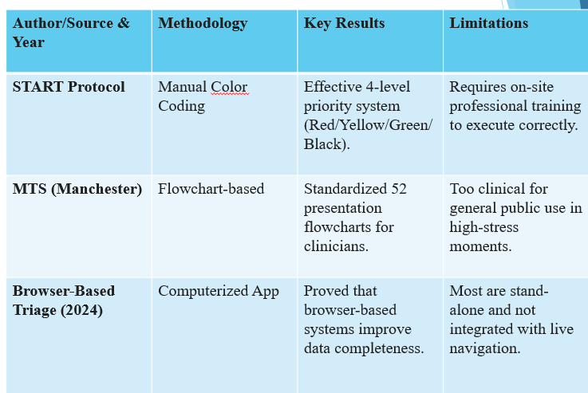

Slide 7
Limitations of existing Systems
List of limitations identified through the literature survey, which will be addressed by the proposed system (MediNear)
Lack of personalized doctor recommendations based on user preferences
Limited accessibility in rural and low-network areas
Complex and less intuitive user interface in some applications
Long waiting queues and delays in appointment scheduling
Inefficient handling of real-time doctor availability
Data privacy and security concerns in managing medical records
Limited focus on user-friendly and fast appointment booking experience
Notes:
7

Slide 8
Proposed Solution:
To develop a system that reduces dependency on manual appointment booking
To improve patient convenience and save time
To provide a centralized digital healthcare platform

Slide 9
Problem statement and Objectives
In the current healthcare system, patients face difficulty in finding suitable doctors and booking appointments efficiently
Existing platforms have limitations such as complex interfaces, lack of personalization, and limited accessibility
There is no simple and efficient system that provides real-time doctor availability and easy appointment booking
Hence, there is a need to develop a system that improves accessibility, usability, and efficiency in healthcare services

Slide 10
Objectives
To design and develop a user-friendly MediNear application
To allow users to search doctors by location, specialization, and ratings
To enable online appointment booking with real-time availability
To maintain secure digital records of patients and appointments
To provide notifications and reminders for scheduled appointments
To improve interaction between doctors and patients through a digital platform
To make healthcare services more efficient, accessible, and reliable

Slide 11
Proposed Methodology
MediNear system is designed as a web-based healthcare application
Location-Based Services (LBS): Used to find nearby doctors and clinics
Search & Filtering Algorithms: For doctor recommendations based on specialization, etc.
Database Management Systems: Store patient, doctor, and appointment data
Cloud Computing: For scalable and secure data storage
Authentication & Security Techniques: To protect sensitive medical data
Mobile & Web Technologies: For user interaction and interface design
Notes:
11

Slide 12
Backend manages:
User data
Doctor details
Appointment scheduling
The system ensures fast, simple, and user-friendly experience

Slide 13
Experimental Setup
The MediNear system is developed using modern web technologies to ensure efficiency and performance.
The frontend is built using HTML, CSS, and JavaScript, which provides an interactive and user-friendly interface.
The backend system handles application logic, user requests, and data processing.
The system uses a database to store and manage all required data, including user information and appointments.
Testing is performed on:
Operating System: Windows Browser: Google Chrome
Functional testing includes checking login, doctor search, appointment booking, guide and map performance.

Slide 14
Development Environment:
VS Code and Firebase Console.
Technologies:
HTML, CSS, JavaScript and Firebase.
OpenStreet map leaflet for map and directions access
Testing Parameters:
Response time, accuracy and mobile compatibility.

Slide 15
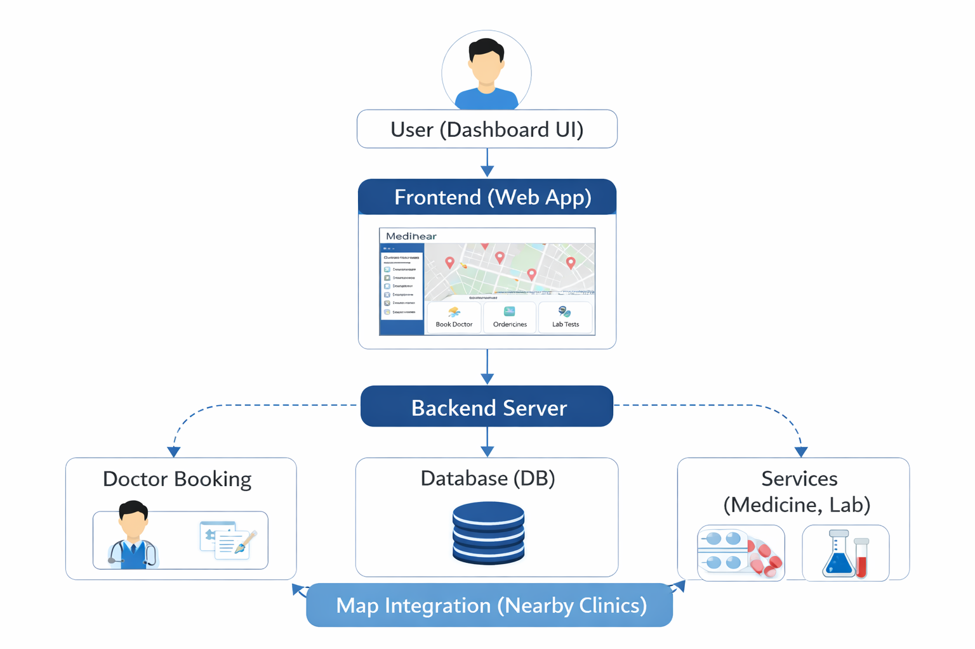

Slide 16
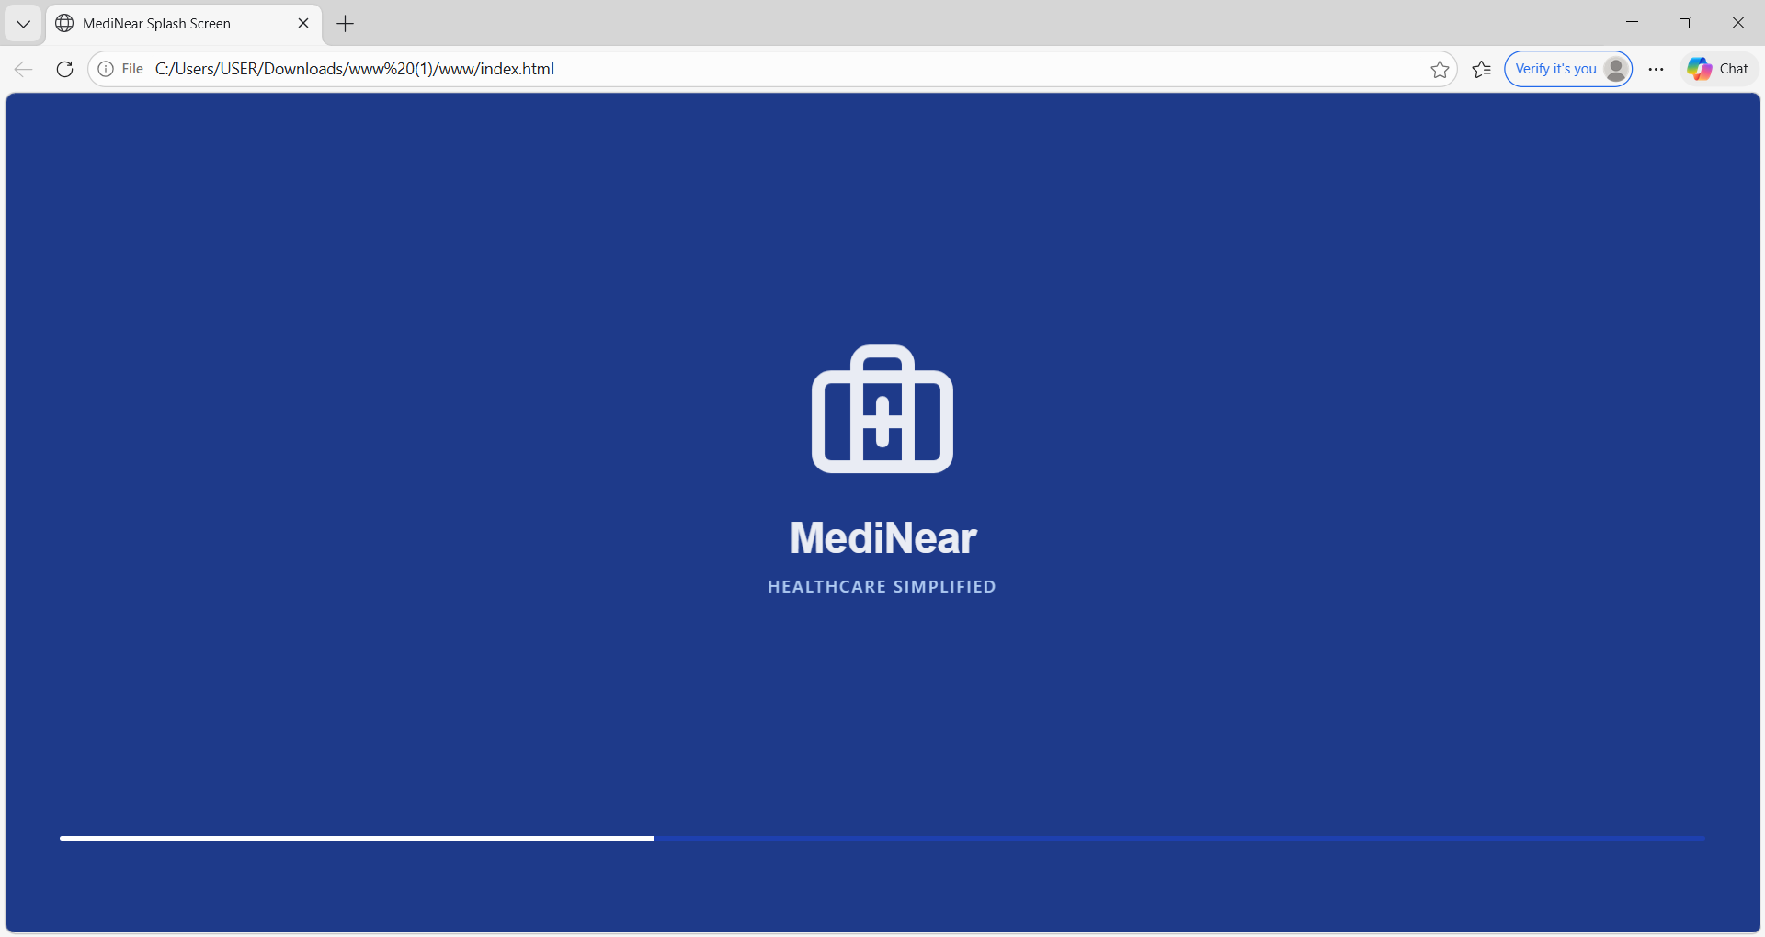
Implementation
Notes:
16

Slide 17
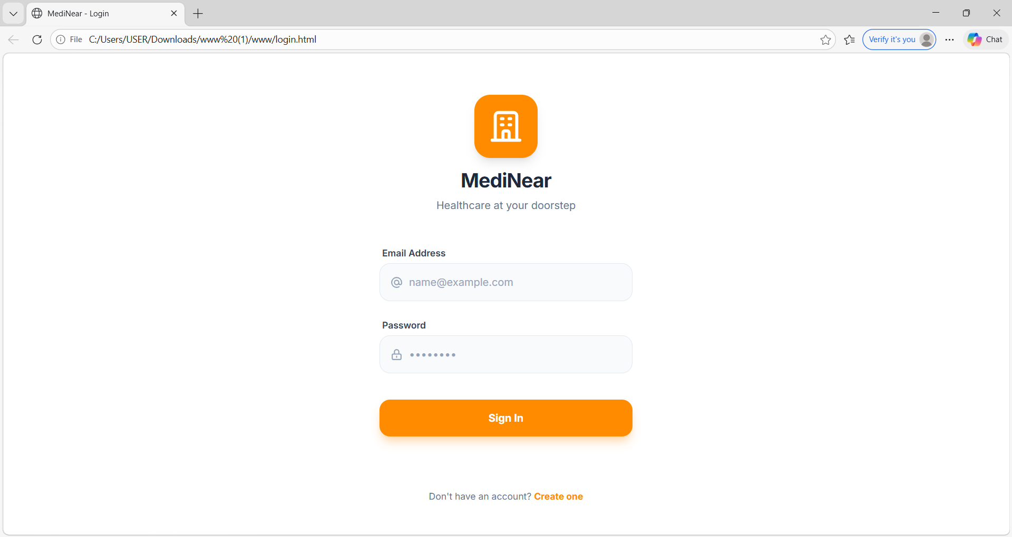

Slide 18
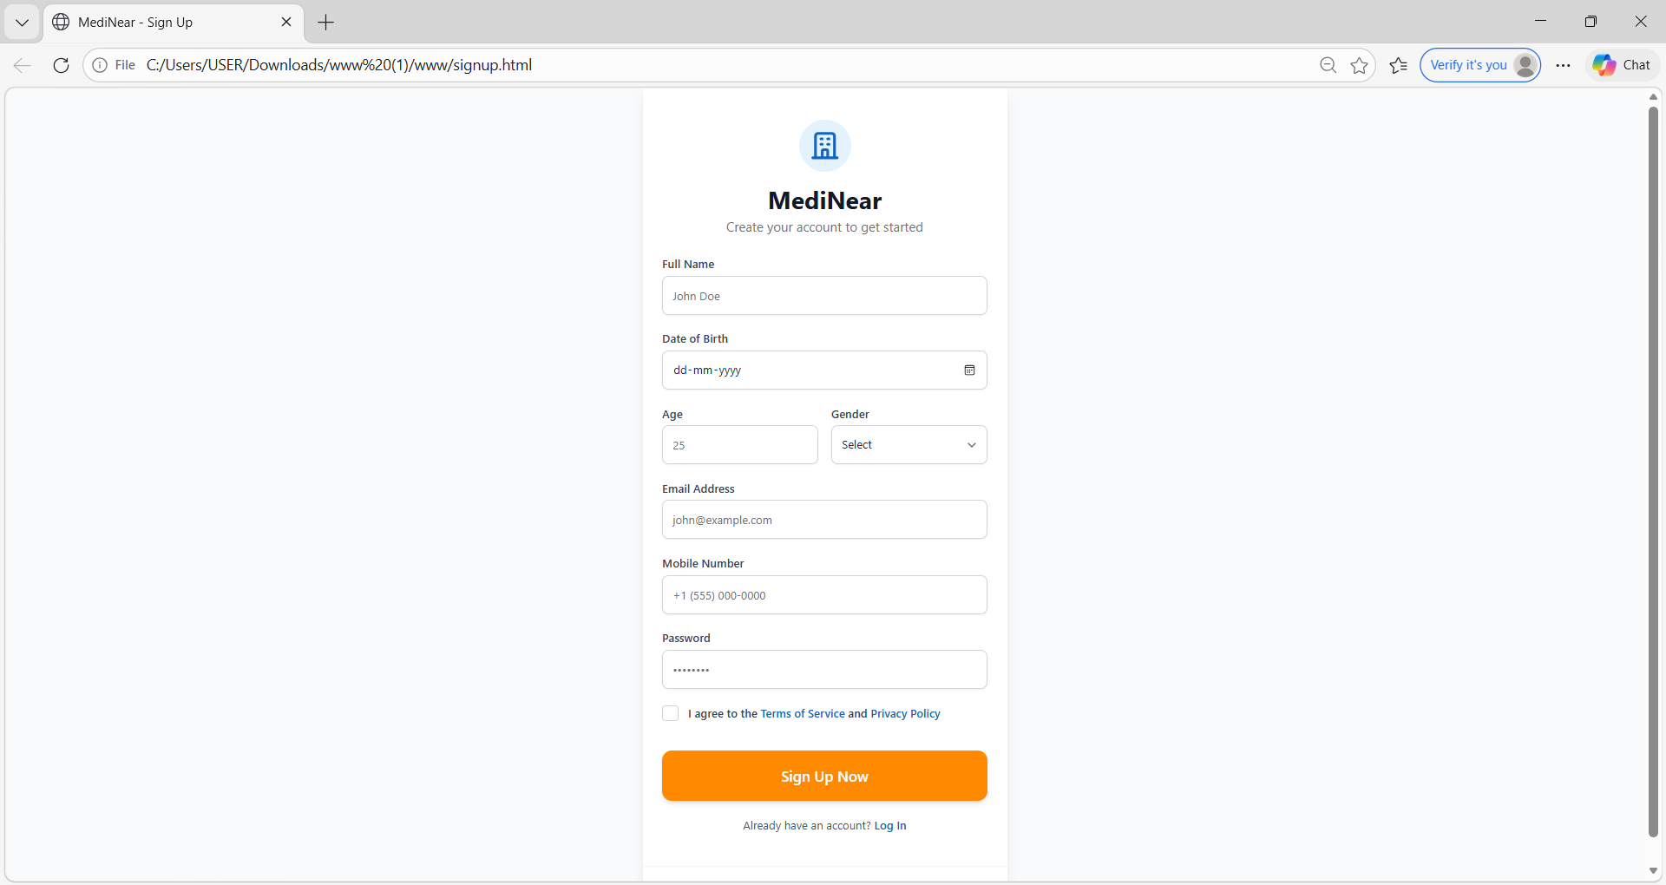

Slide 19
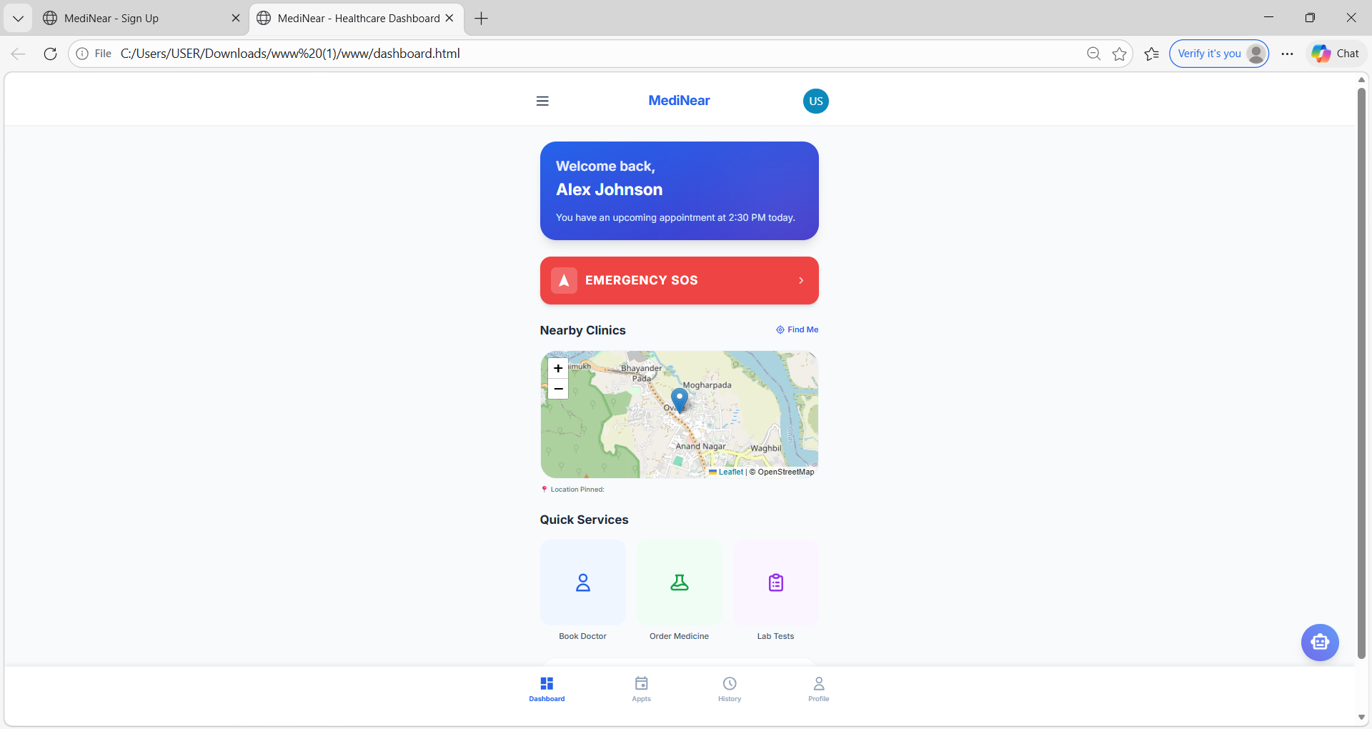
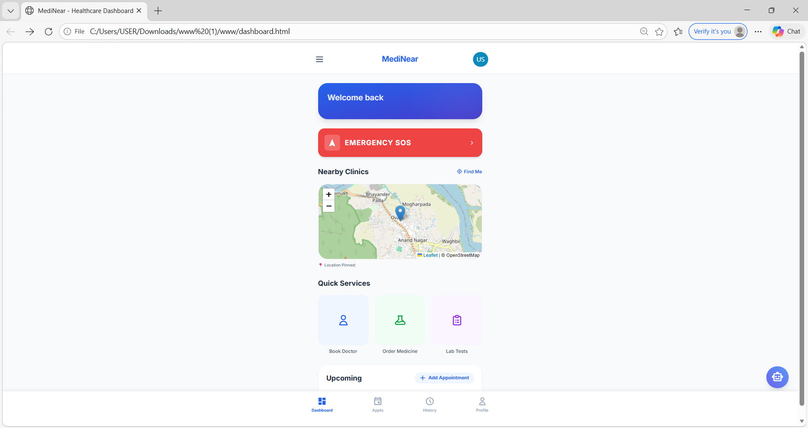

Slide 20
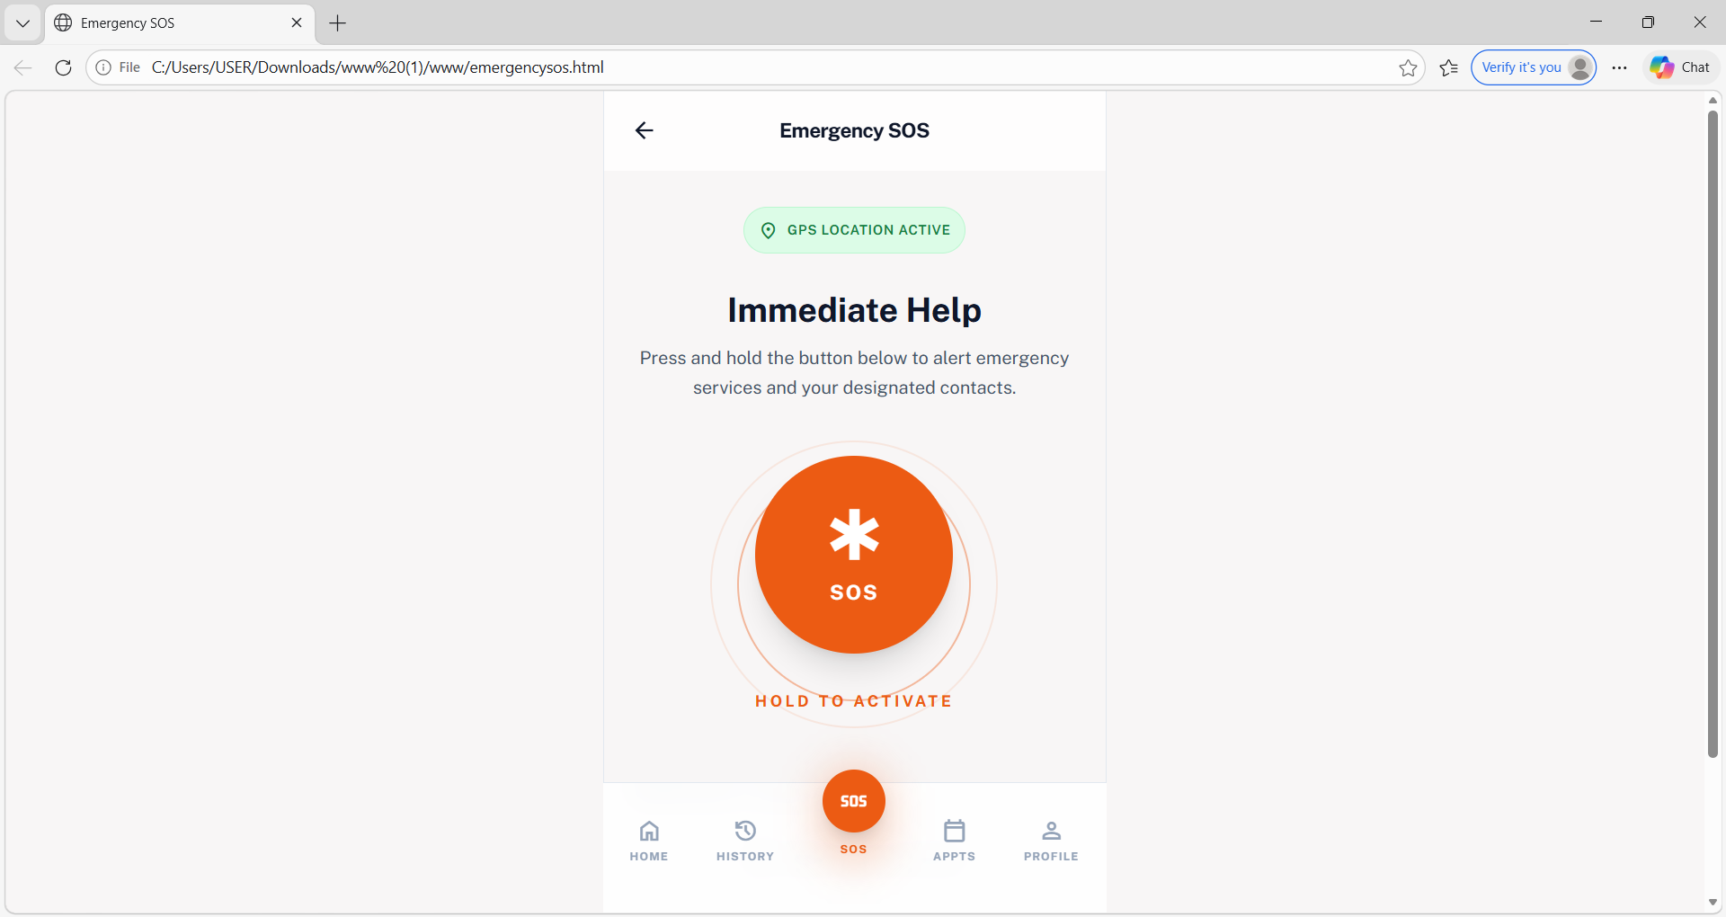

Slide 21
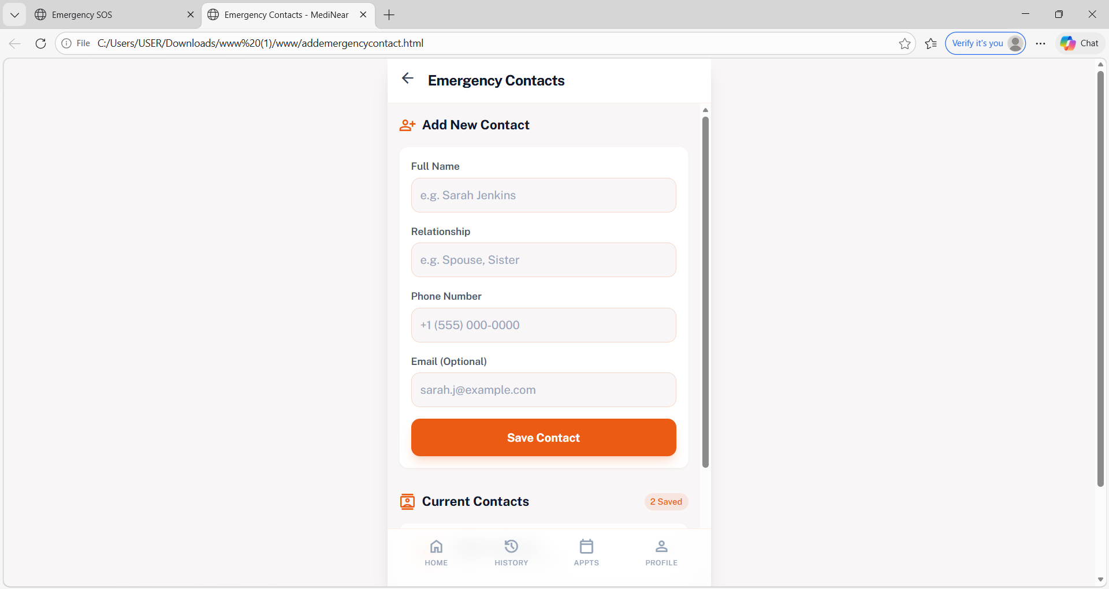

Slide 22
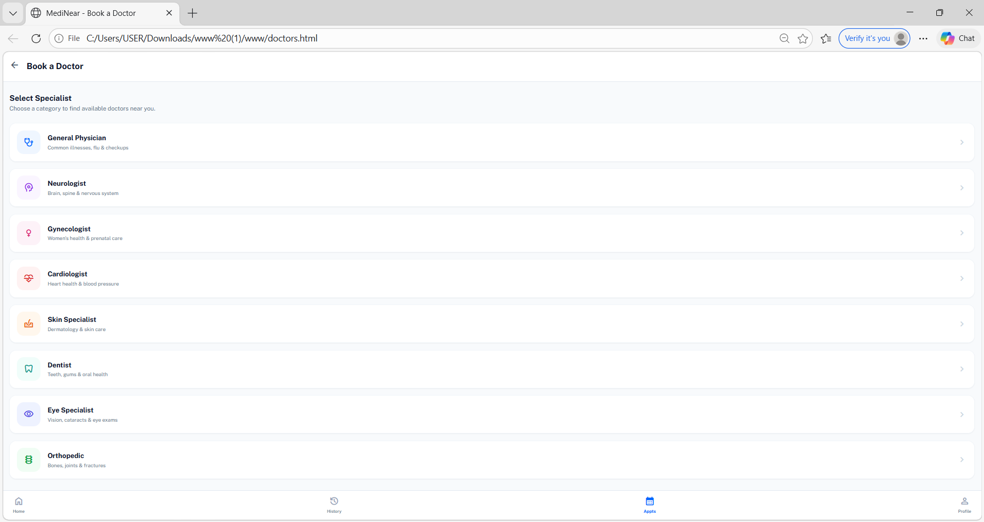

Slide 23
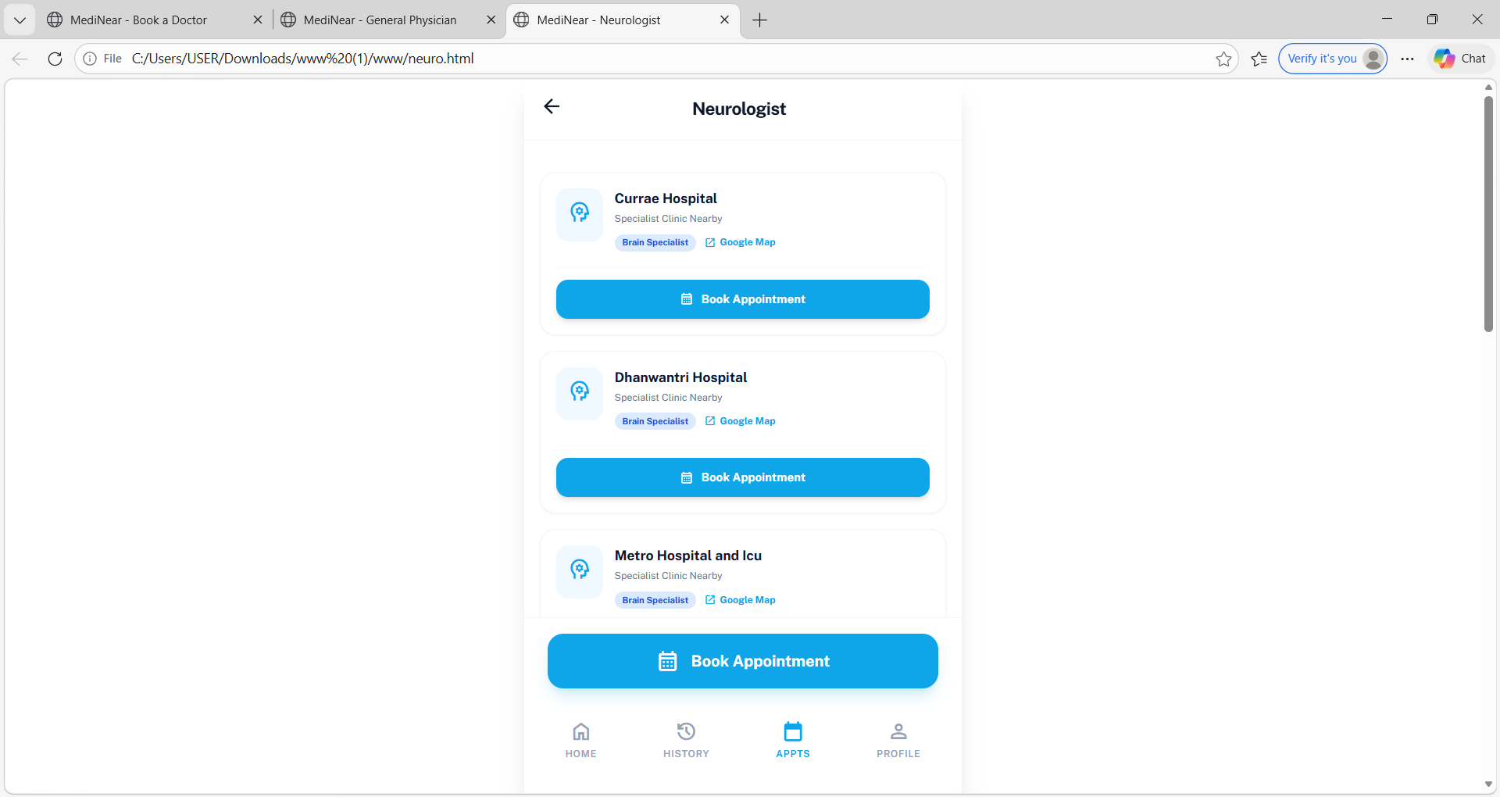

Slide 24
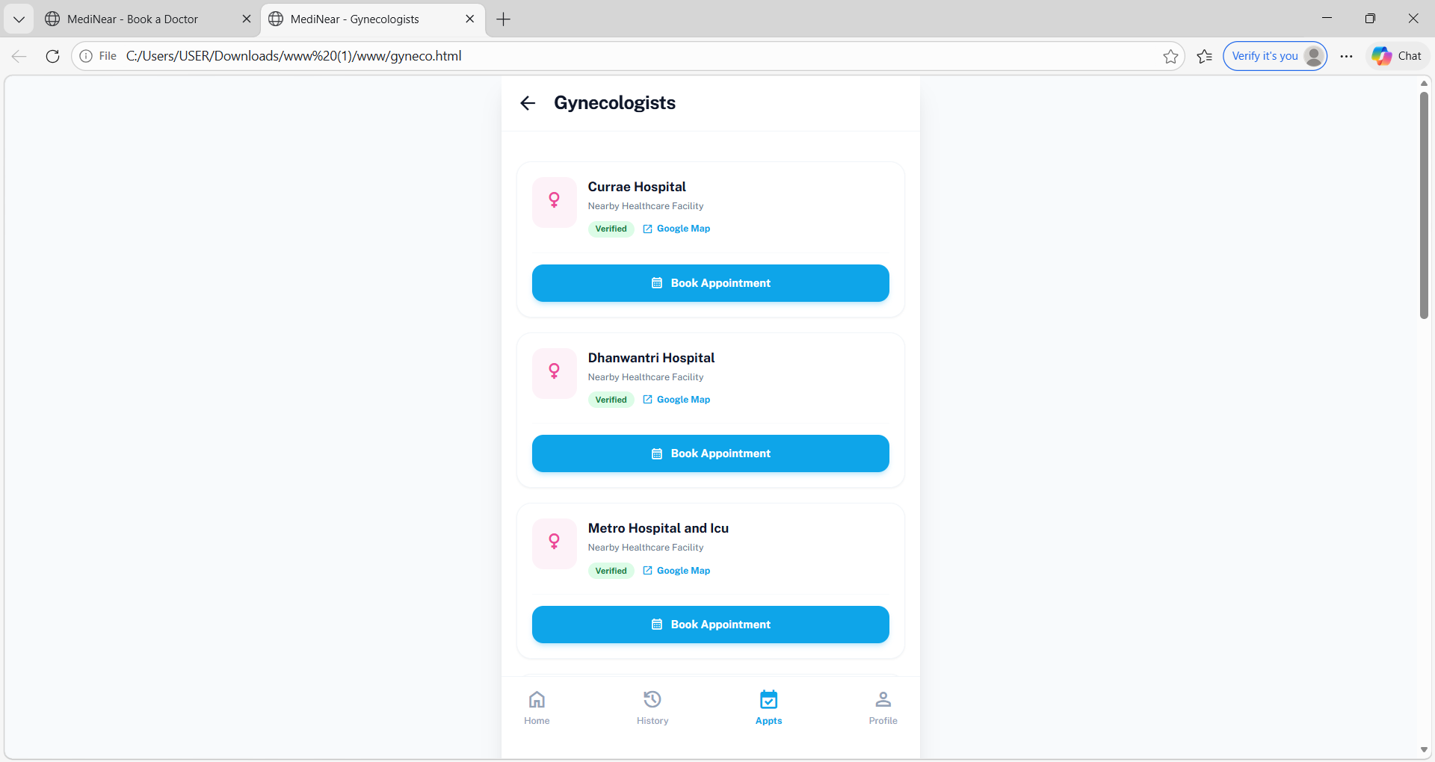

Slide 25
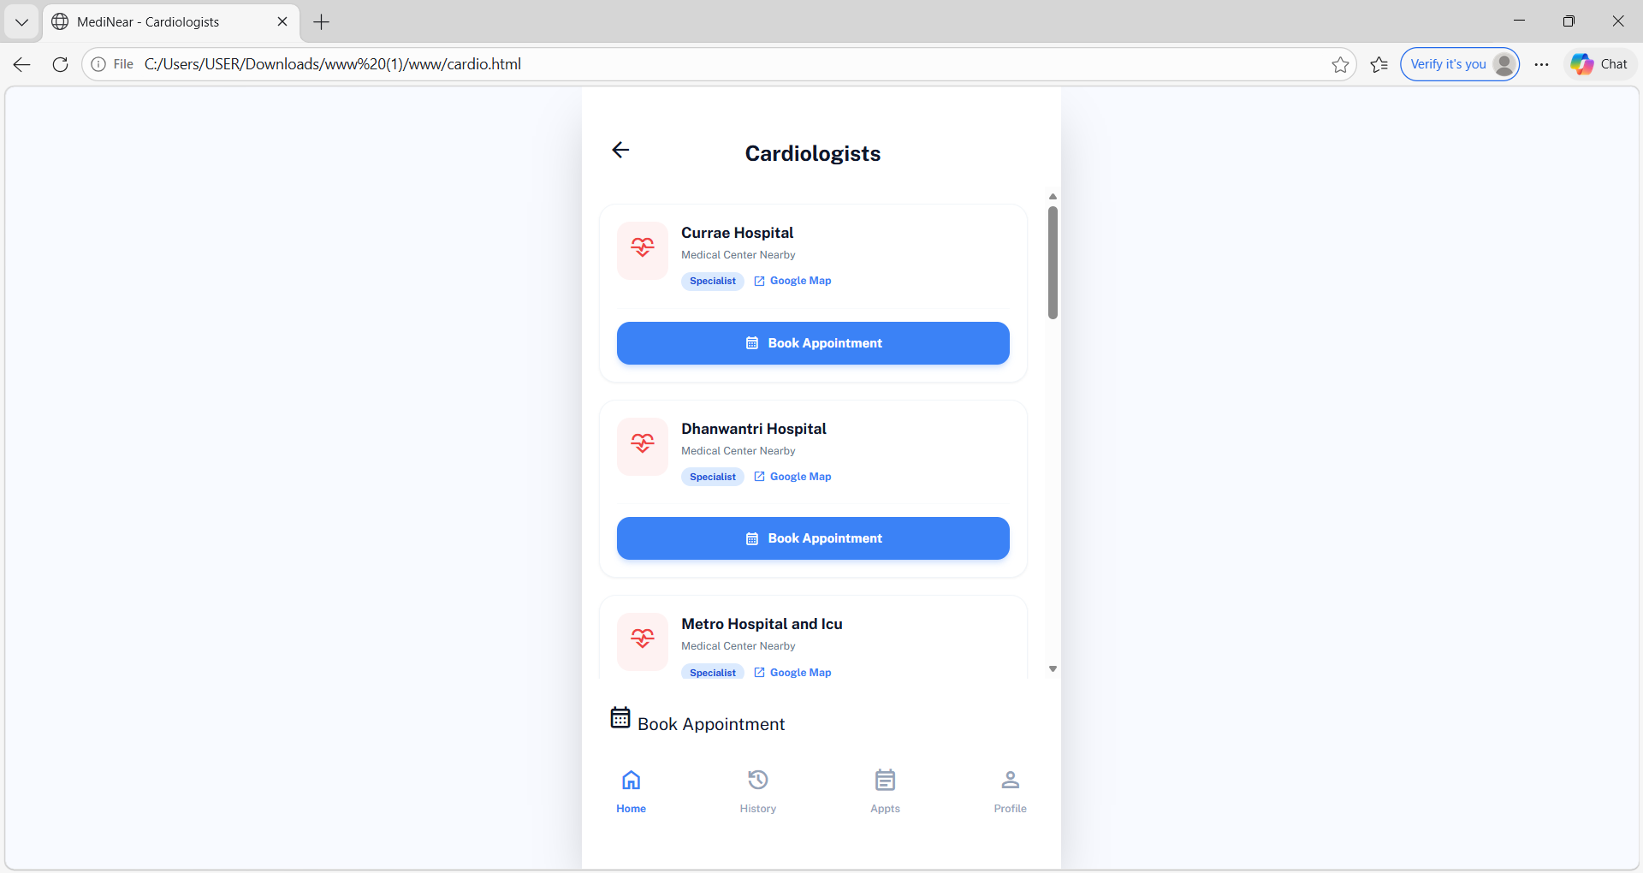

Slide 26
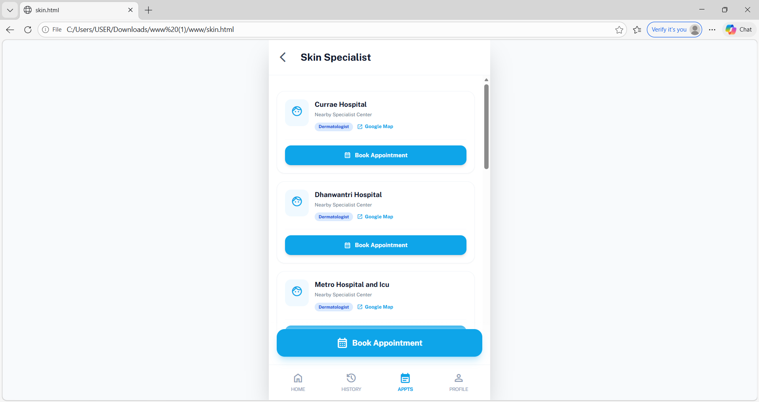

Slide 27
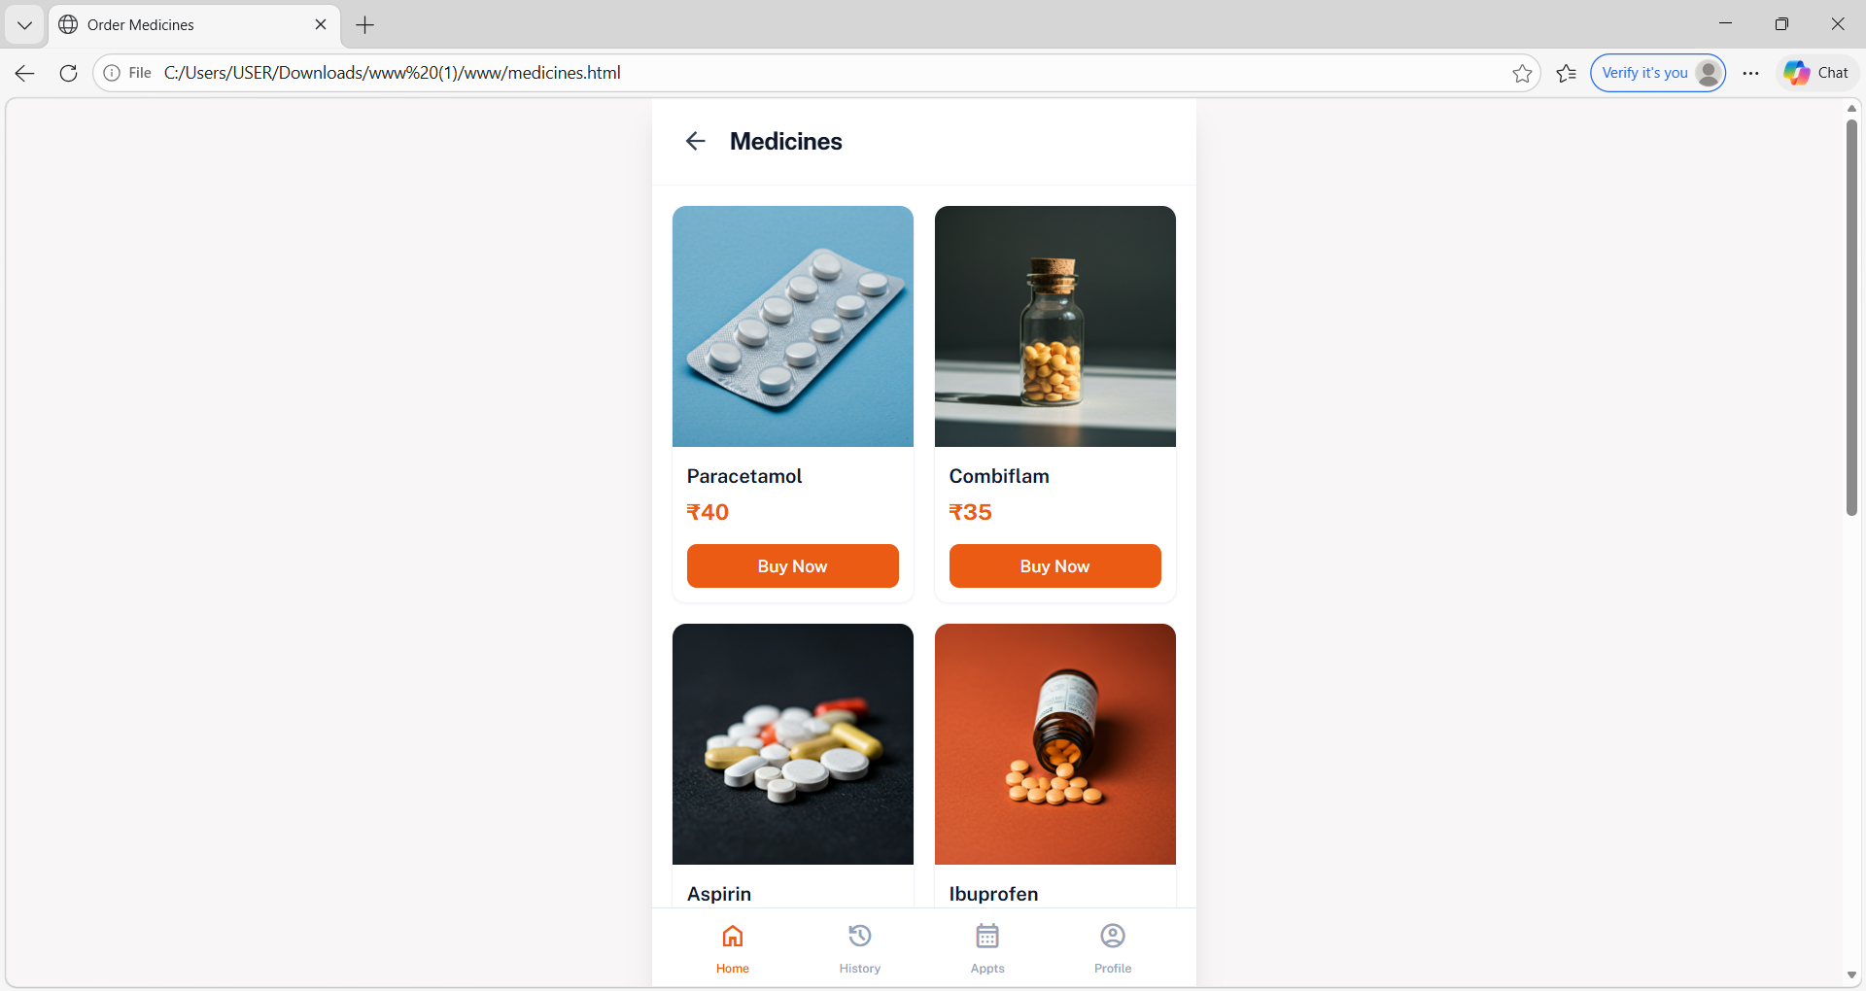

Slide 28
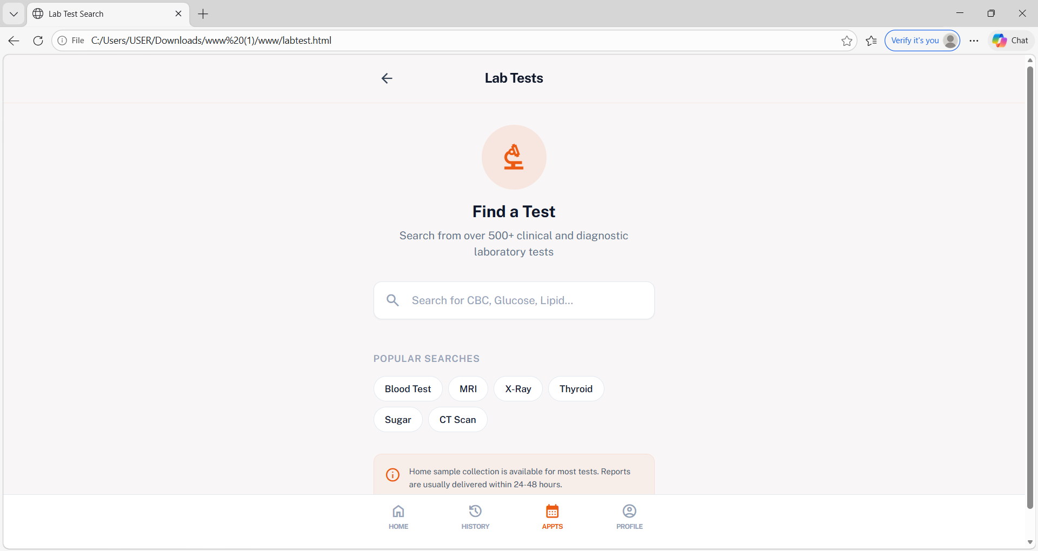

Slide 29
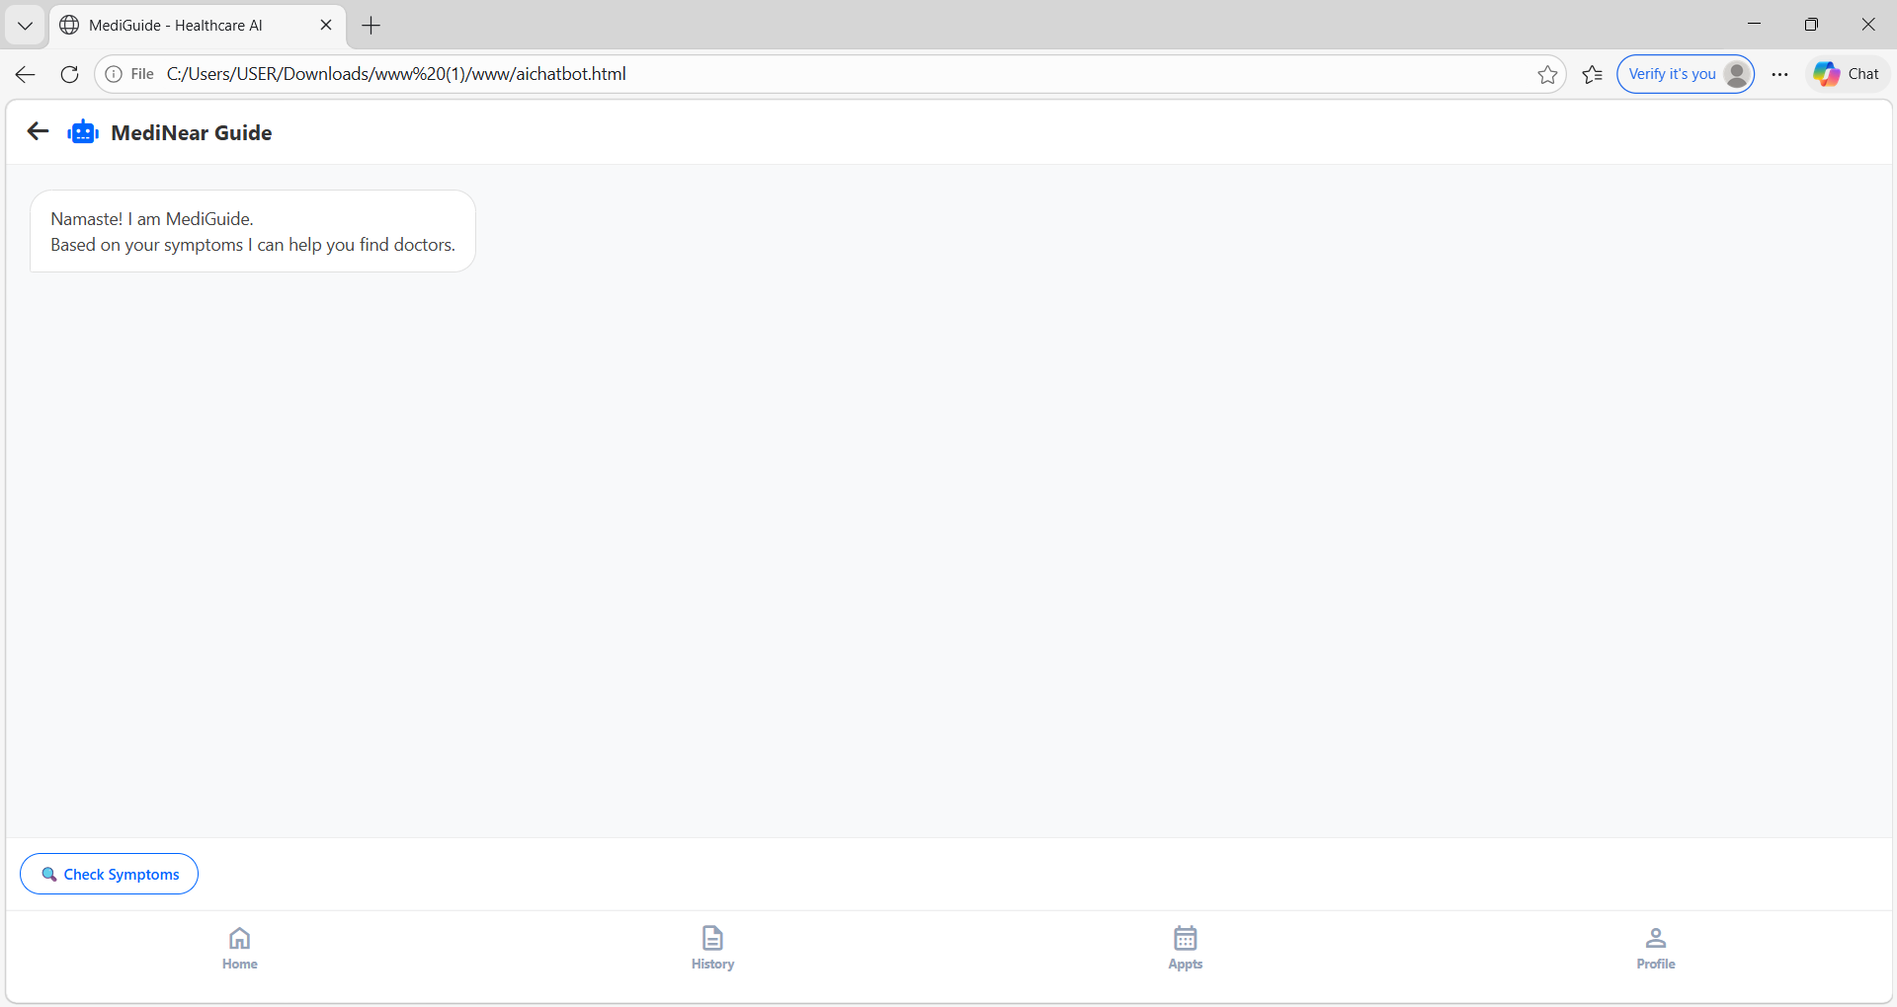

Slide 30
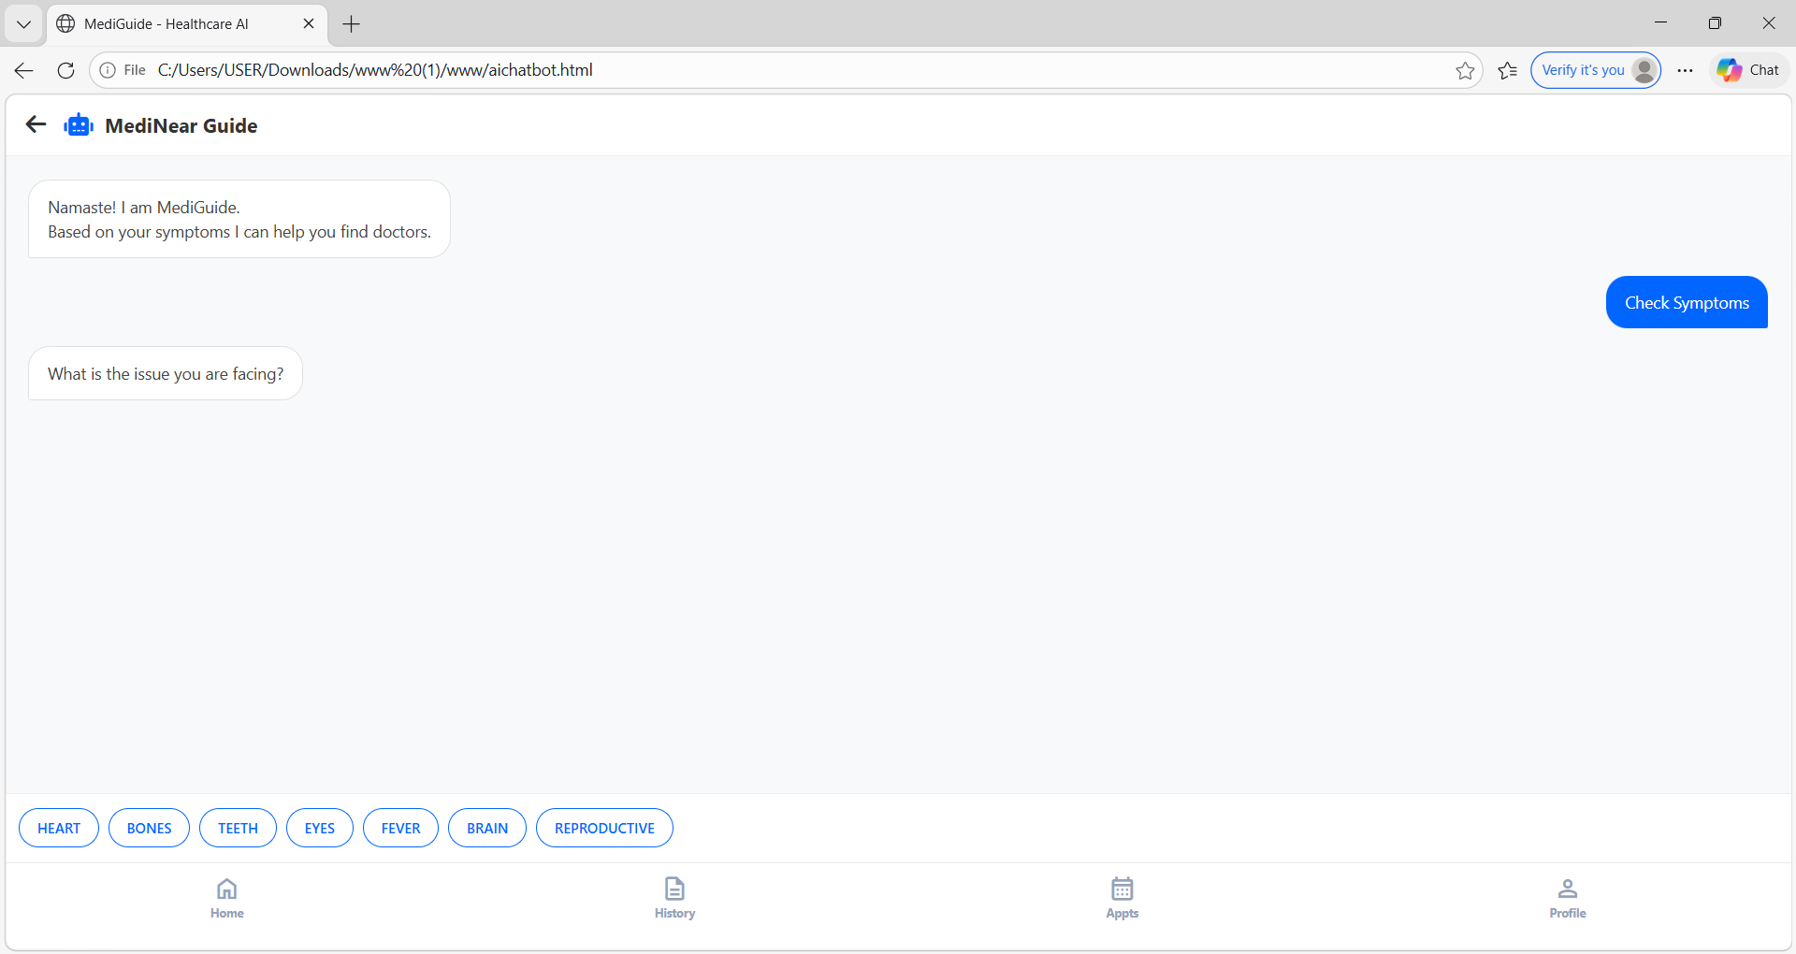

Slide 31
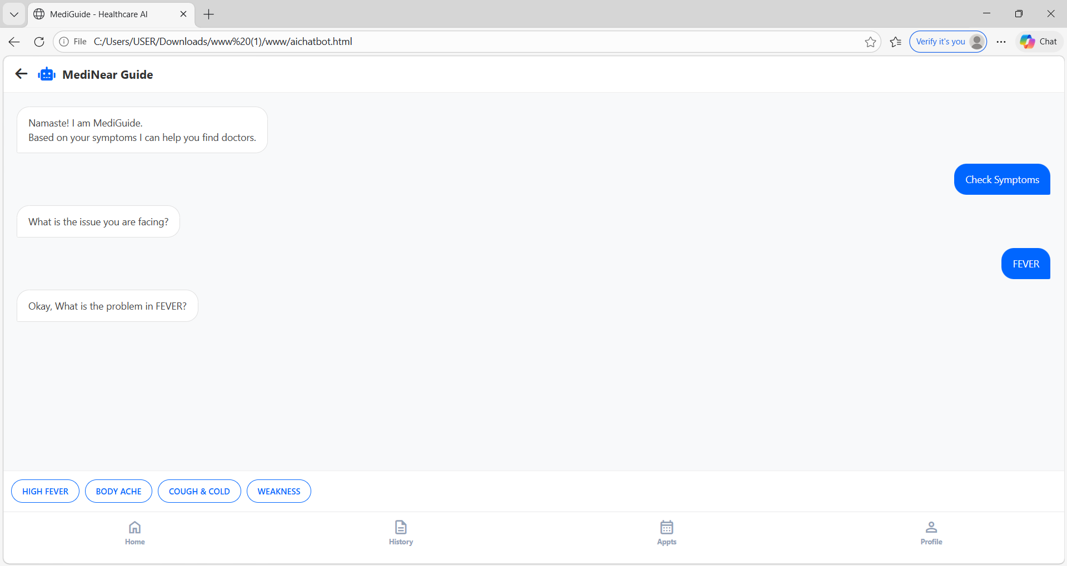

Slide 32
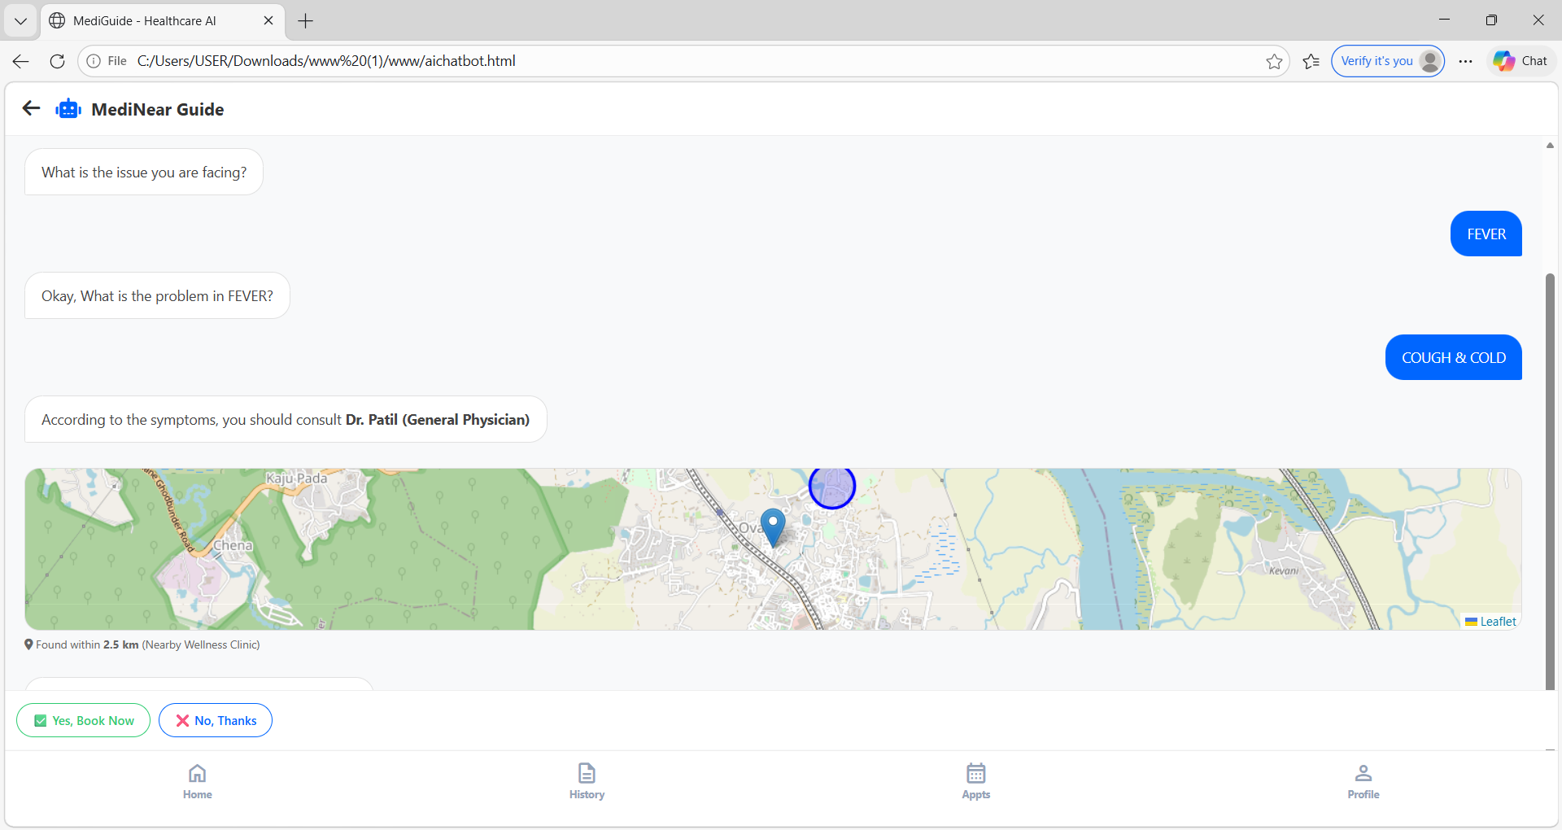

Slide 33
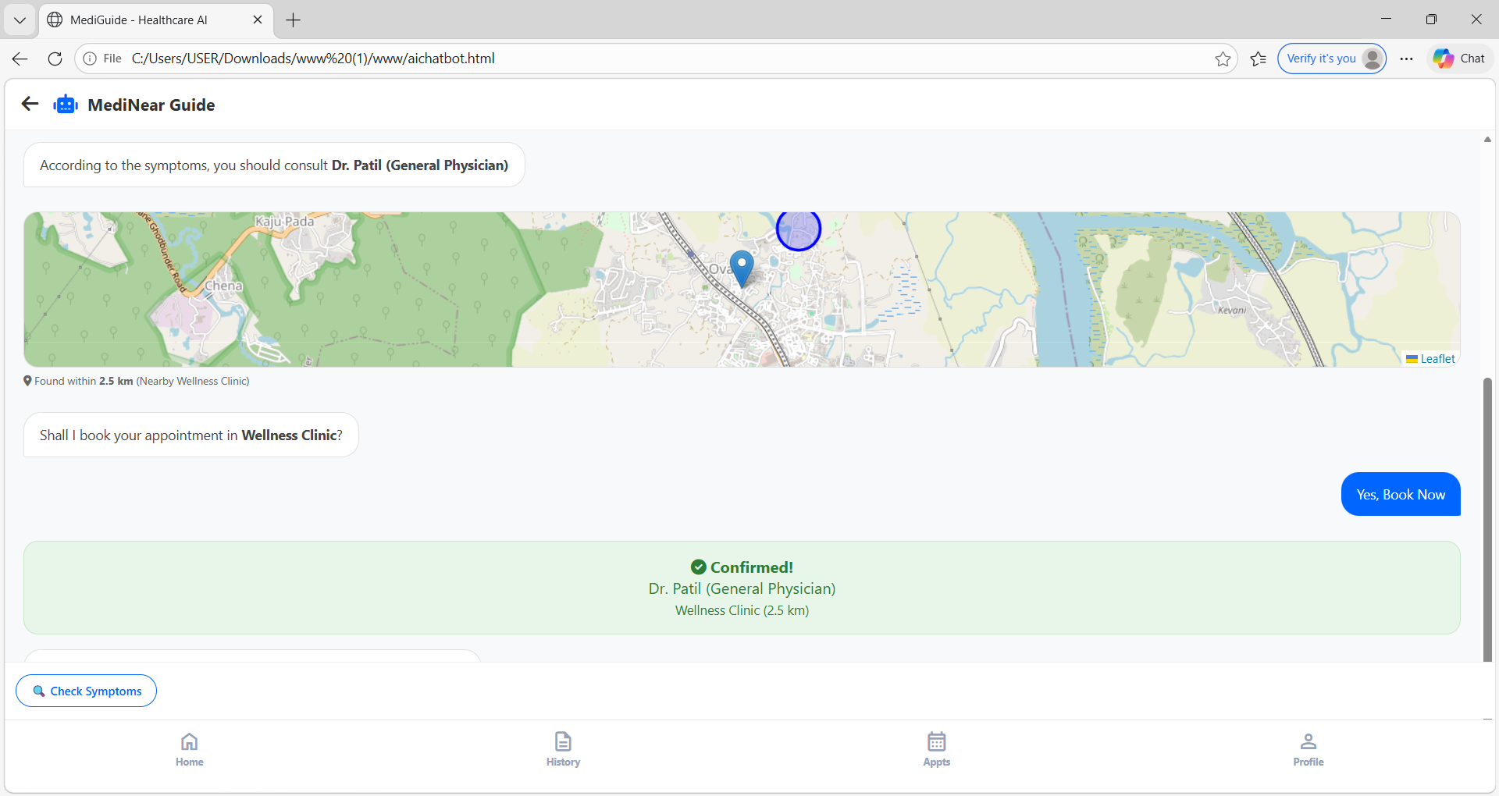

Slide 34
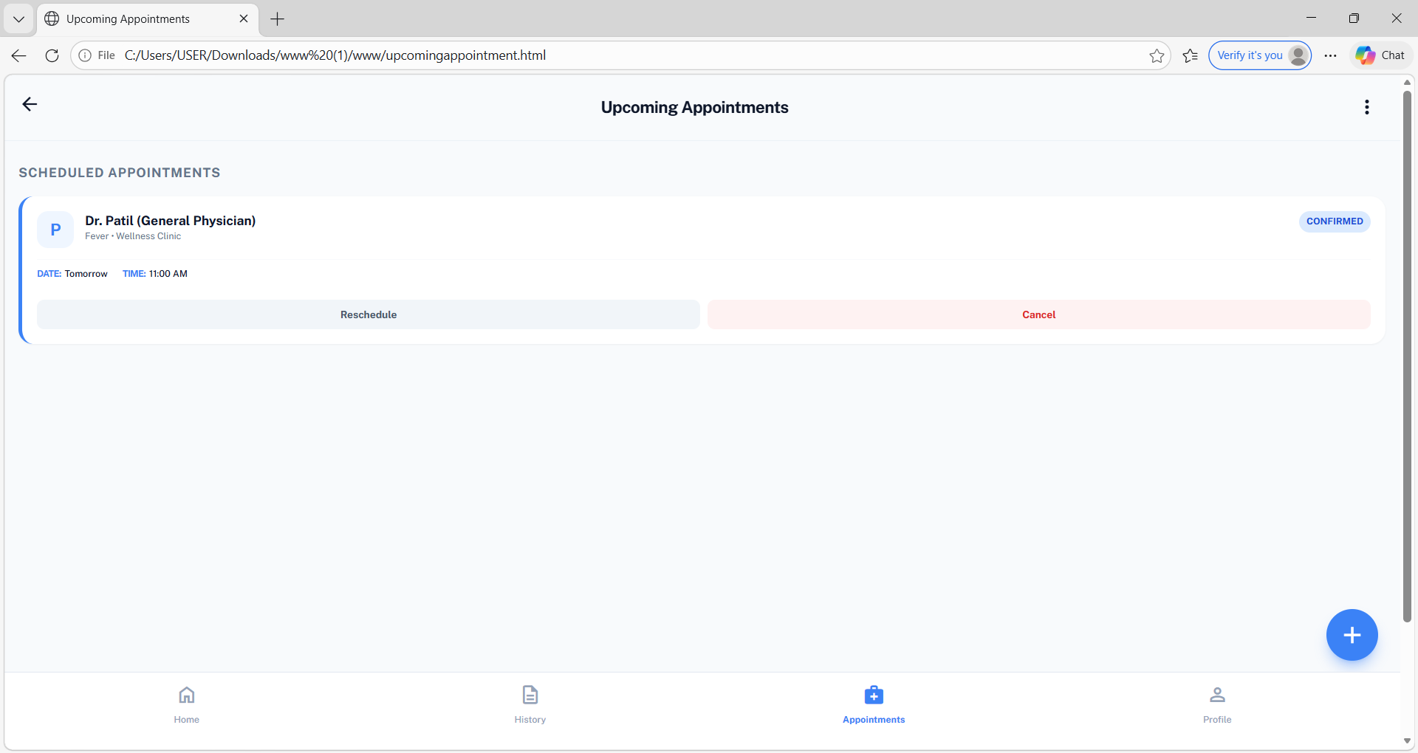

Slide 35
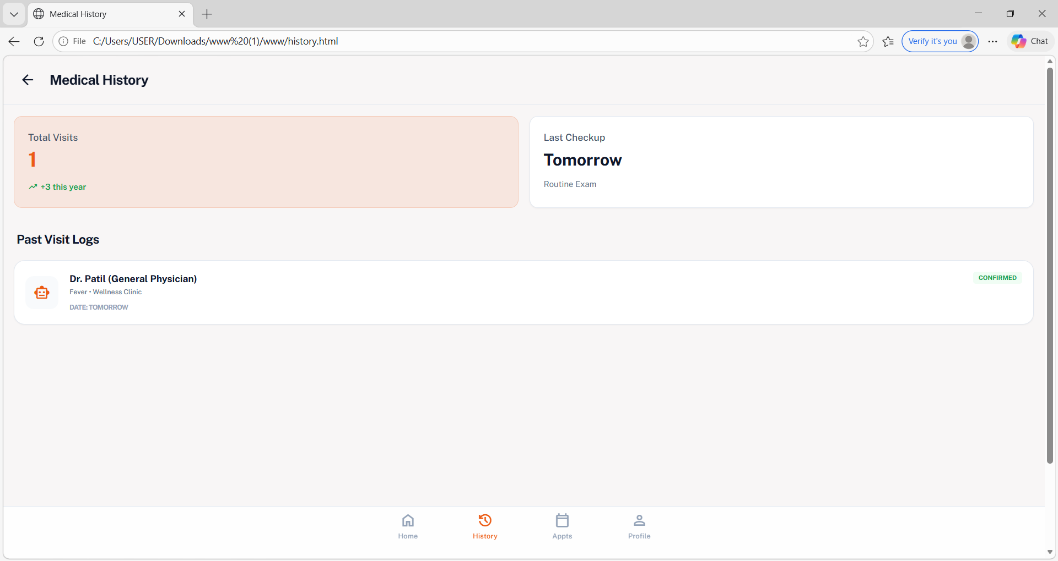

Slide 36
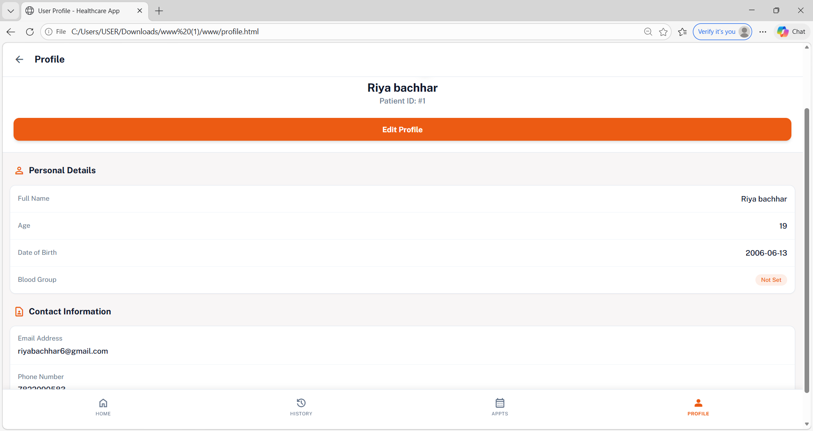

Slide 37
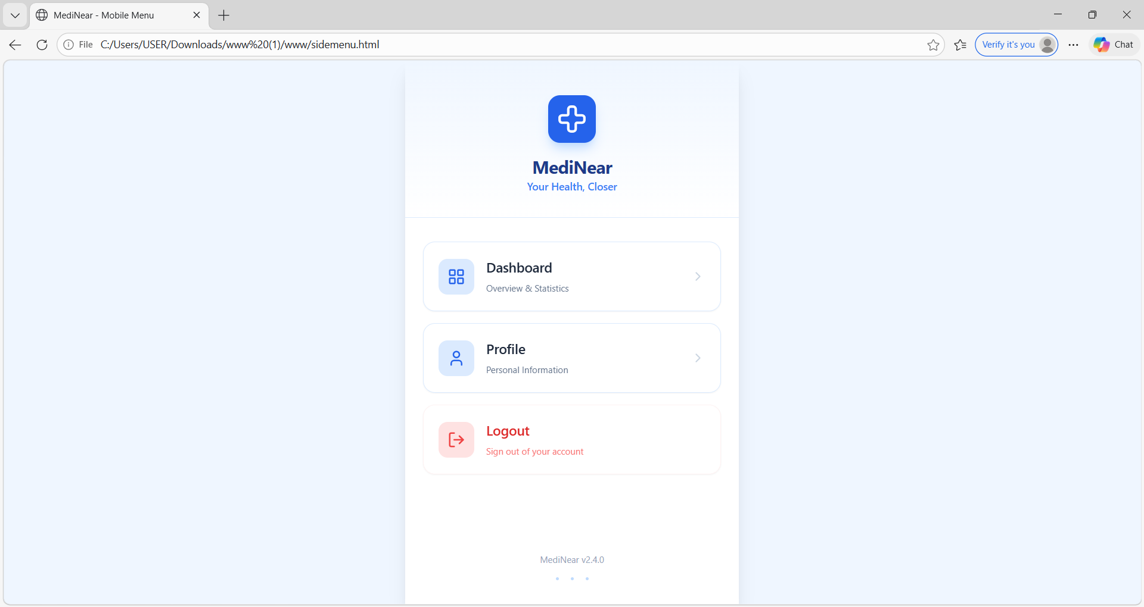

Slide 38
Results & Analysis
The MediNear system was successfully implemented and tested for all core functionalities.
Users were able to easily search for doctors and book appointments without difficulty.
The system showed improved performance in terms of:
Faster response time Ease of use Reduced complexity
Compared to traditional methods and existing applications, MediNear provides a more user-friendly and efficient experience.
Notes:
38

Slide 39
Conclusion and Future work
MediNear is a smart healthcare solution that simplifies access to medical services.
It successfully integrates doctor search, appointment booking, and Map-based guidance into a single platform.
The use of a guide improves user interaction and helps users make better healthcare decisions.
The system enhances accessibility, efficiency, and overall user experience in the healthcare domain.
MediNear proves to be a reliable and scalable solution for modern digital healthcare needs.
Notes:
39

Slide 40
References
All references must strictly follow IEEE citation format.
Include DOI or official publisher link (IEEE Xplore / Springer / ACM / ScienceDirect) for each paper.
Avoid citing blogs, Wikipedia, or non-academic websites.
Every reference listed must be cited in the report and PPT.
Notes:
40

Slide 41
Thank You...!!
Notes:
41

